Slide 1
Real-Time Object Detection using YOLO and OpenCV
Harshwardhan Bichitkar
20220802118

Slide 2
Introduction
Object Detection is identifying objects in images or video.
It is used in security, traffic systems, and more.
This project detects objects in real-time using webcam.
It uses YOLOv8 model and OpenCV.

Slide 3
Tools and Technologies
Python - Programming language
OpenCV - For video and drawing boxes
YOLOv8 (Ultralytics) - AI object detection model
Webcam - Captures live video feed

Slide 4
How It Works
Video is captured frame-by-frame using webcam.
Each frame is passed to YOLO model.
Model returns object boxes and labels.
Boxes and labels are drawn using OpenCV.
Live video is shown with detected objects.

Slide 5
Output and Demo
Detects objects like person, phone, bottle, etc.
Boxes and labels appear on screen.
Detected object names printed in console.
Press ‘q’ to stop the webcam.

Slide 6
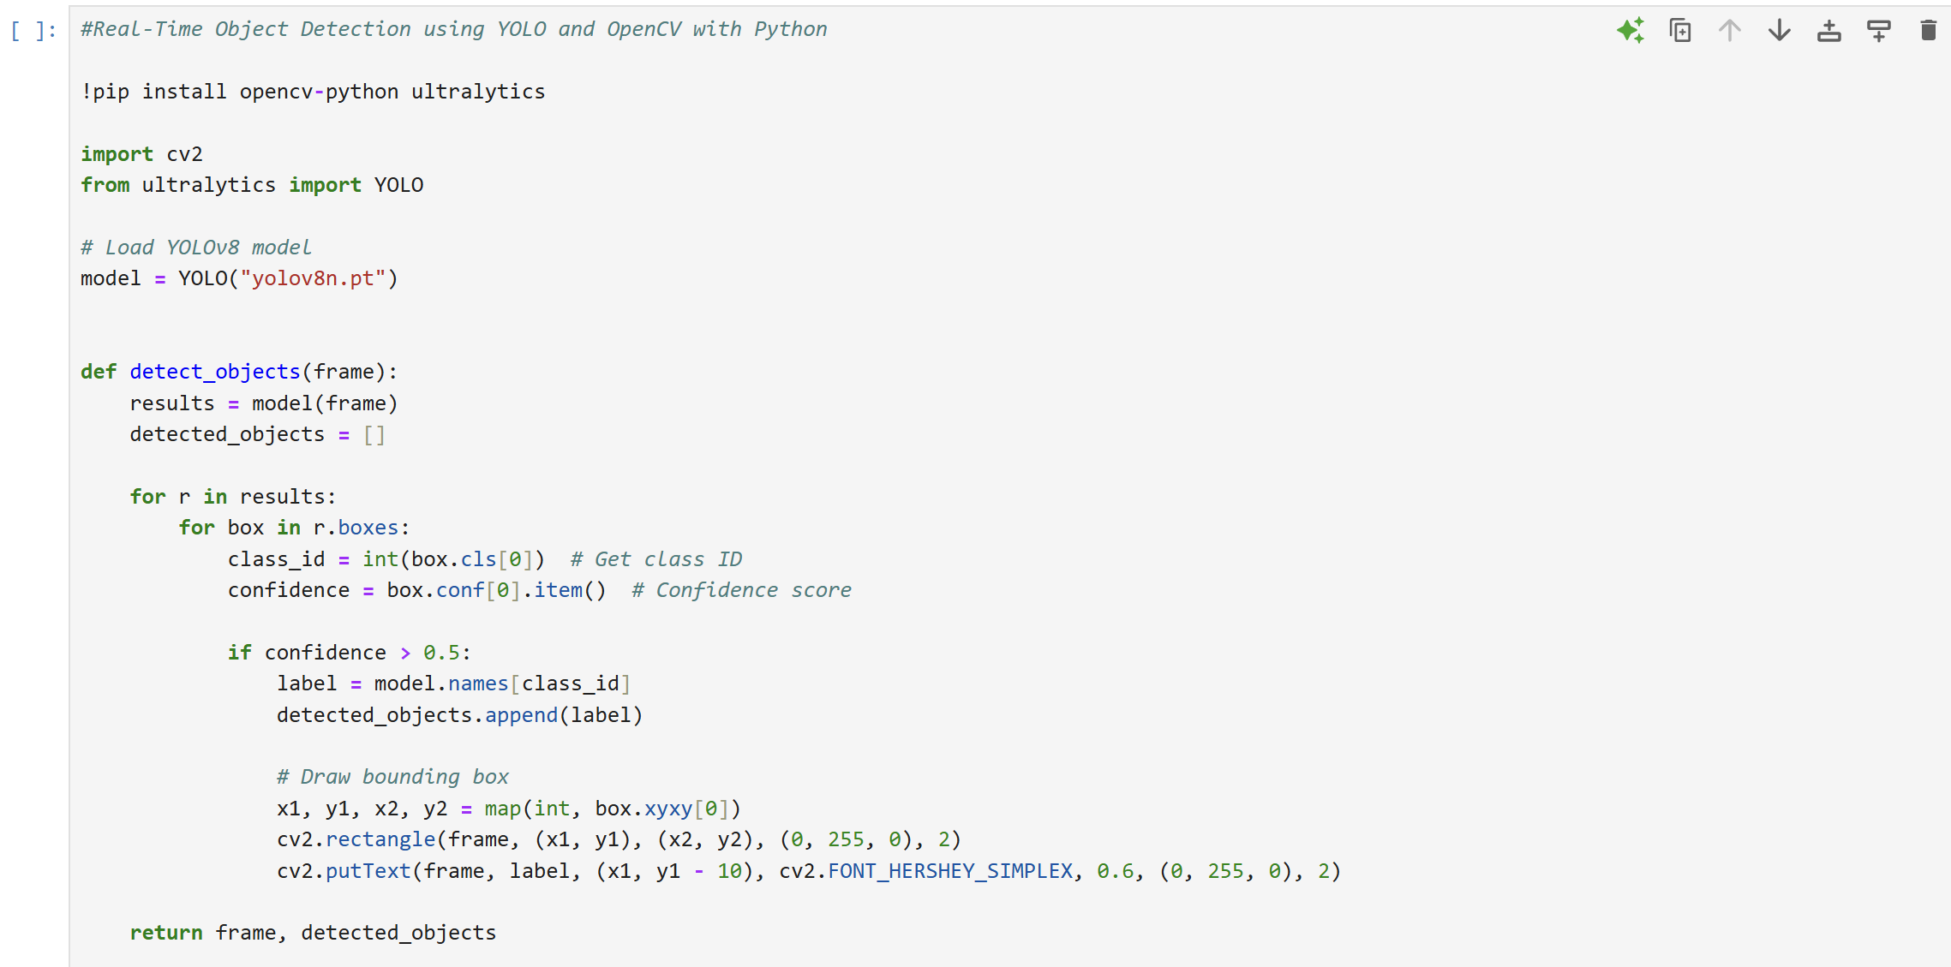
CODE

Slide 7
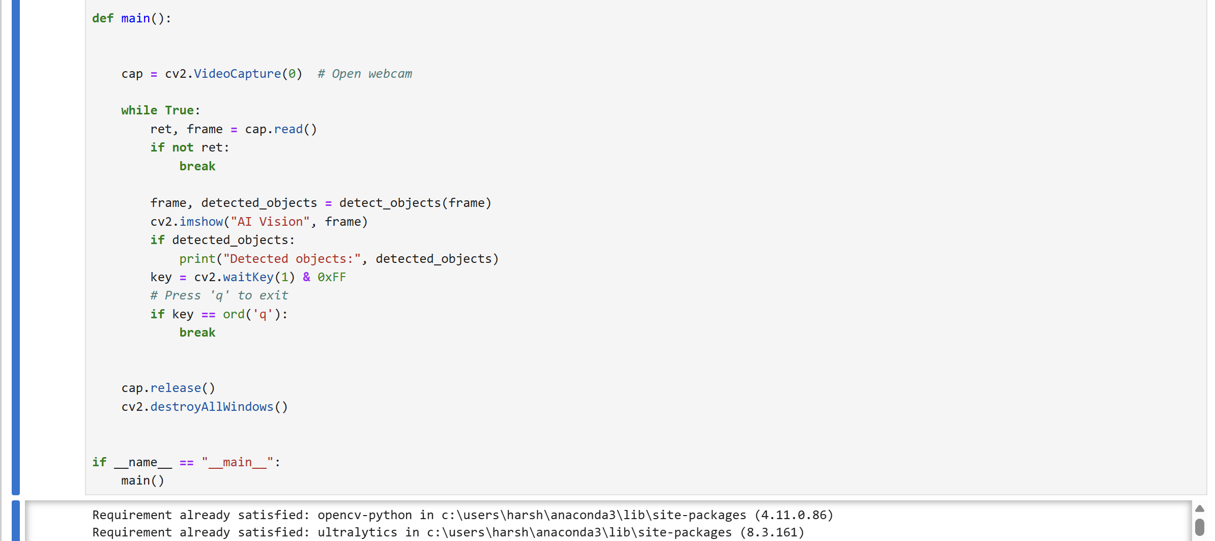
CODE

Slide 8
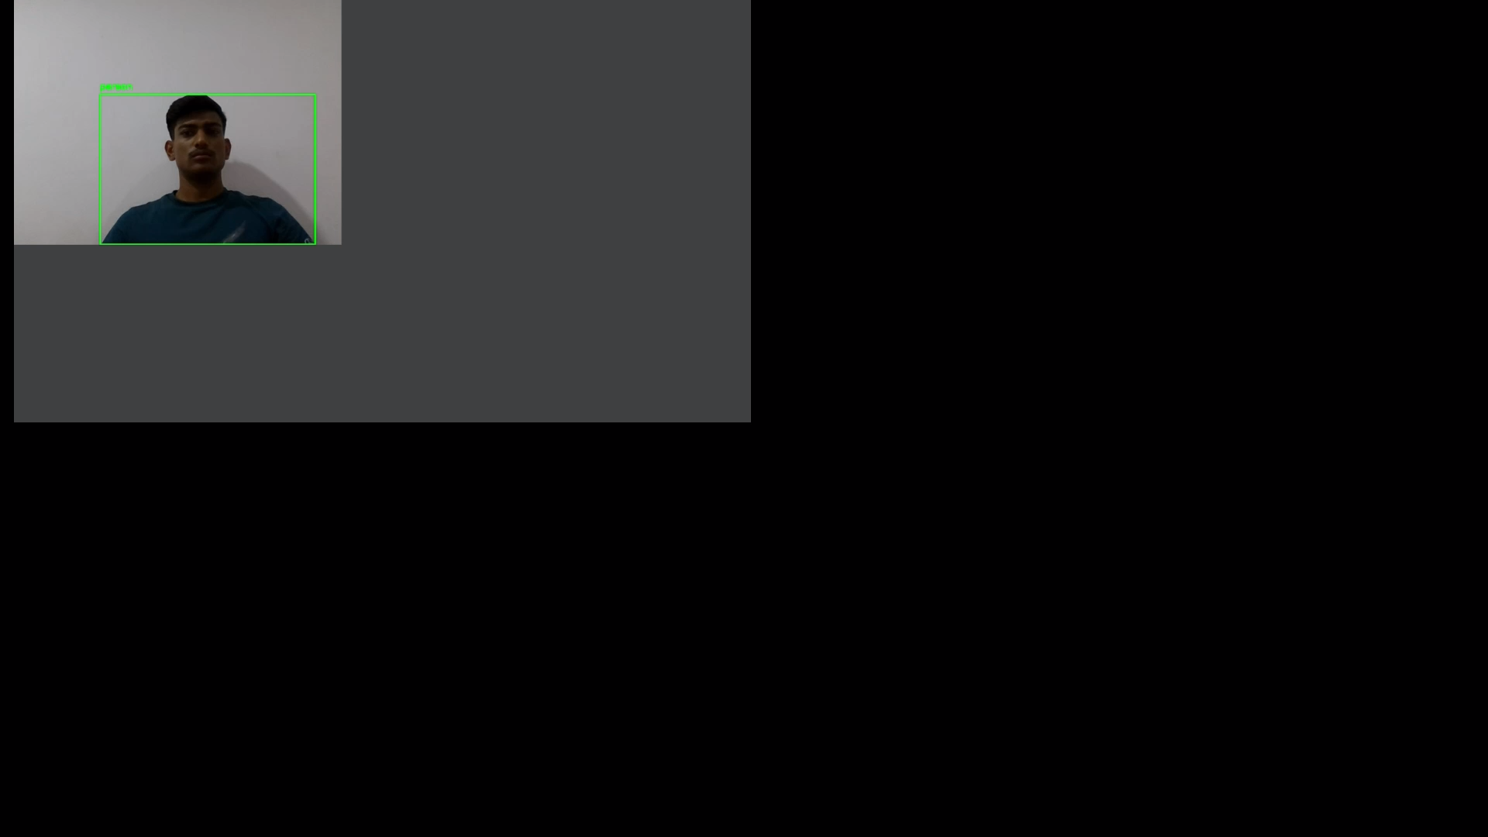
Video

Slide 9
Conclusion
Learned to use AI with real-time video input.
Useful for automation, safety, and surveillance.
Can improve by using more powerful models or data.

